Slide 1
MICROSOFT AZURE DATA ENGINEER
PRESENTED BY : PROF. HARSHITHA V

Slide 2
TOOLS FOR A DATA ENGINEER
Microsoft Azure Data Lake storage
Microsoft Azure Data Factory
Microsoft Azure Databricks
Microsoft Azure Stream Analytics
Microsoft Azure Synapse Analytics

Slide 3
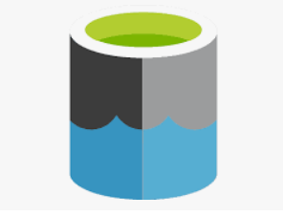
Microsoft Azure Data Lake storage
Azure Data Lake is a highly scalable and secure data storage and analytics service built for big data workloads in the Microsoft Azure cloud.
It enables organizations to store data of any size, shape, and speed, and do all types of processing and analytics across platforms and languages.

Slide 4

Microsoft Azure Data Factory
Azure Data Factory (ADF) is Microsoft’s cloud-based data integration and ETL (Extract, Transform, Load) service.
It allows you to create data-driven workflows (called pipelines) to move and transform data at scale across on-premises, cloud, and hybrid environments.

Slide 5

Microsoft Azure Databricks
Azure Databricks is an Apache Spark-based analytics platform optimized for the Microsoft Azure cloud.
It provides a collaborative, fast, and scalable environment for big data analytics, data engineering, machine learning, and AI workloads.

Slide 6

Microsoft Azure Stream Analytics
Azure Stream Analytics (ASA) is a real-time data stream processing service offered by Microsoft Azure.
It allows you to ingest, process, and analyze streaming data from multiple sources, and then deliver insights or trigger actions—in real time.

Slide 7
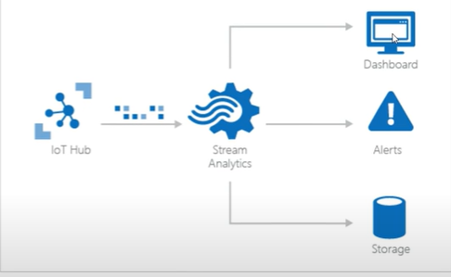

Slide 8

Microsoft Azure Synapse Analytics
Azure Synapse Analytics is an end-to-end analytics platform from Microsoft that combines big data and data warehousing capabilities into a single unified service.
It allows you to ingest, prepare, manage, and serve data for immediate business intelligence and machine learning needs.

Slide 9
THANK YOU

Slide 10
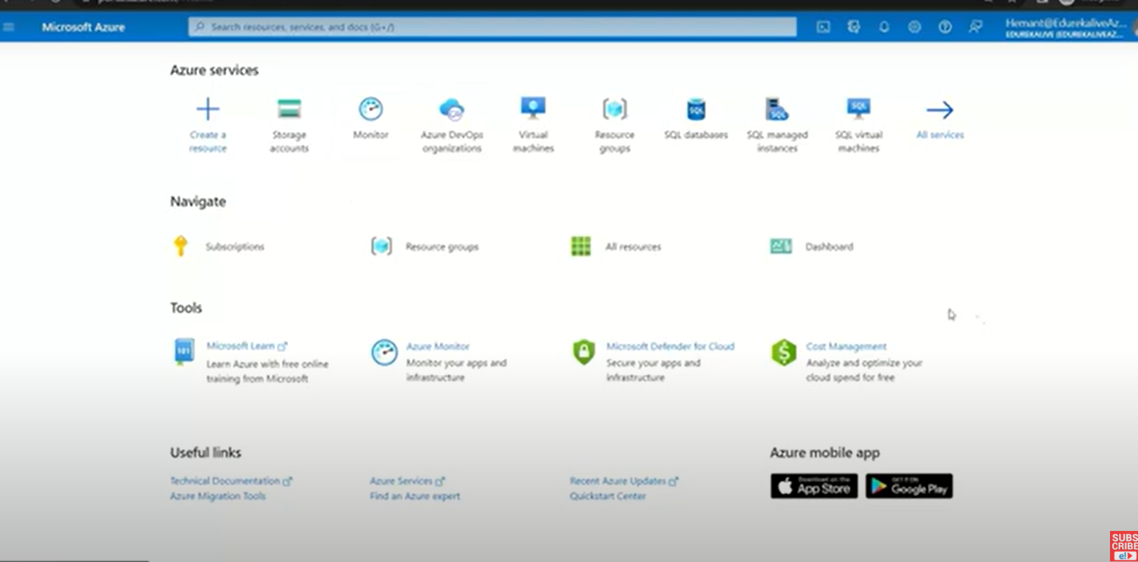

Slide 11
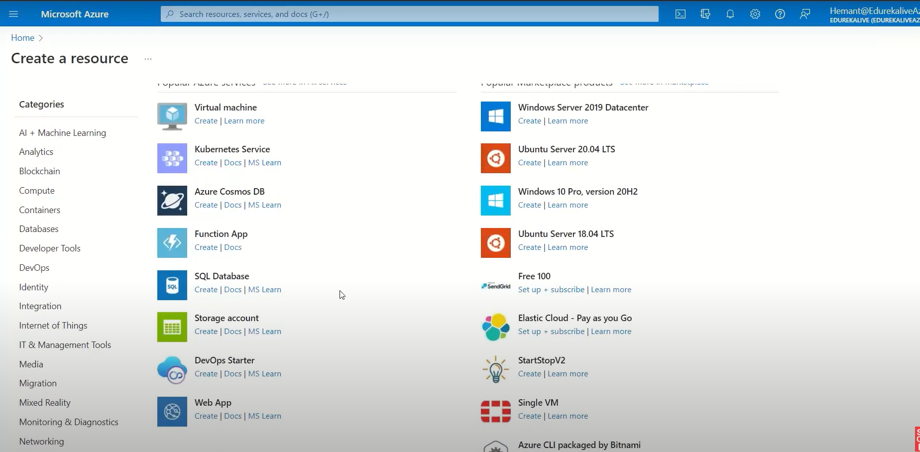

Slide 12
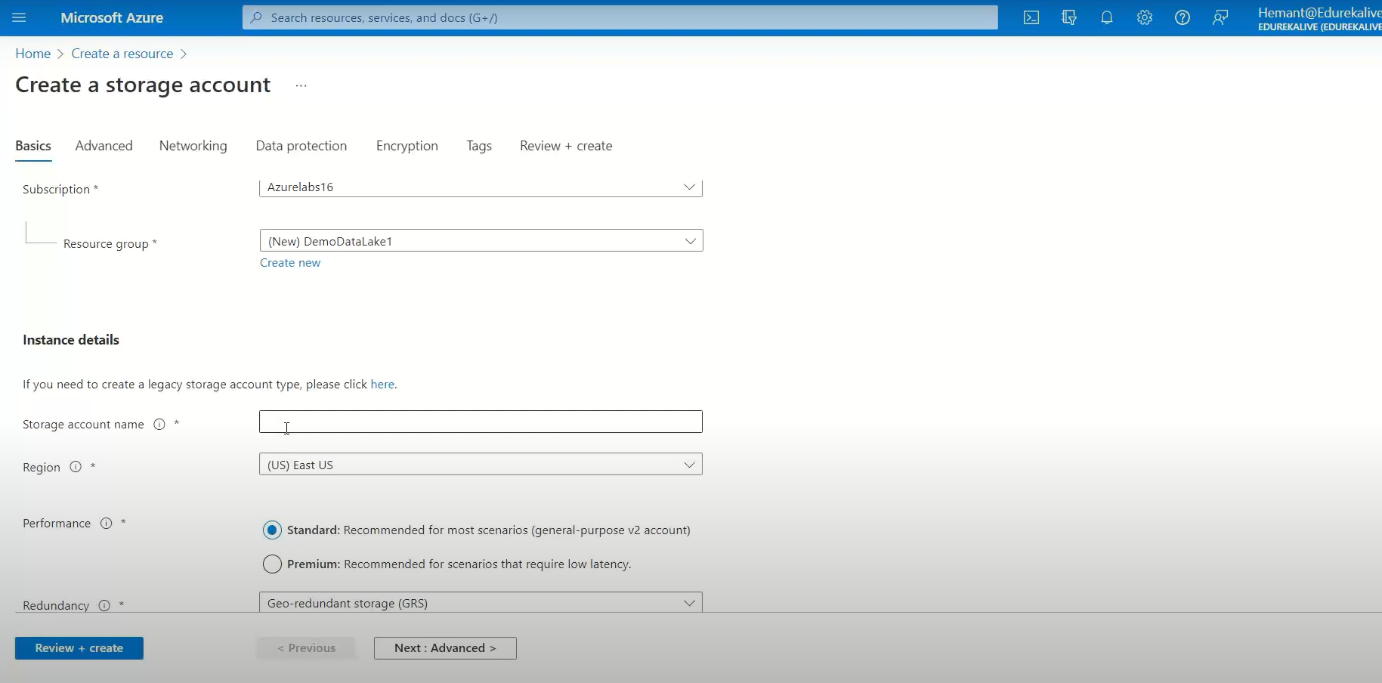

Slide 13
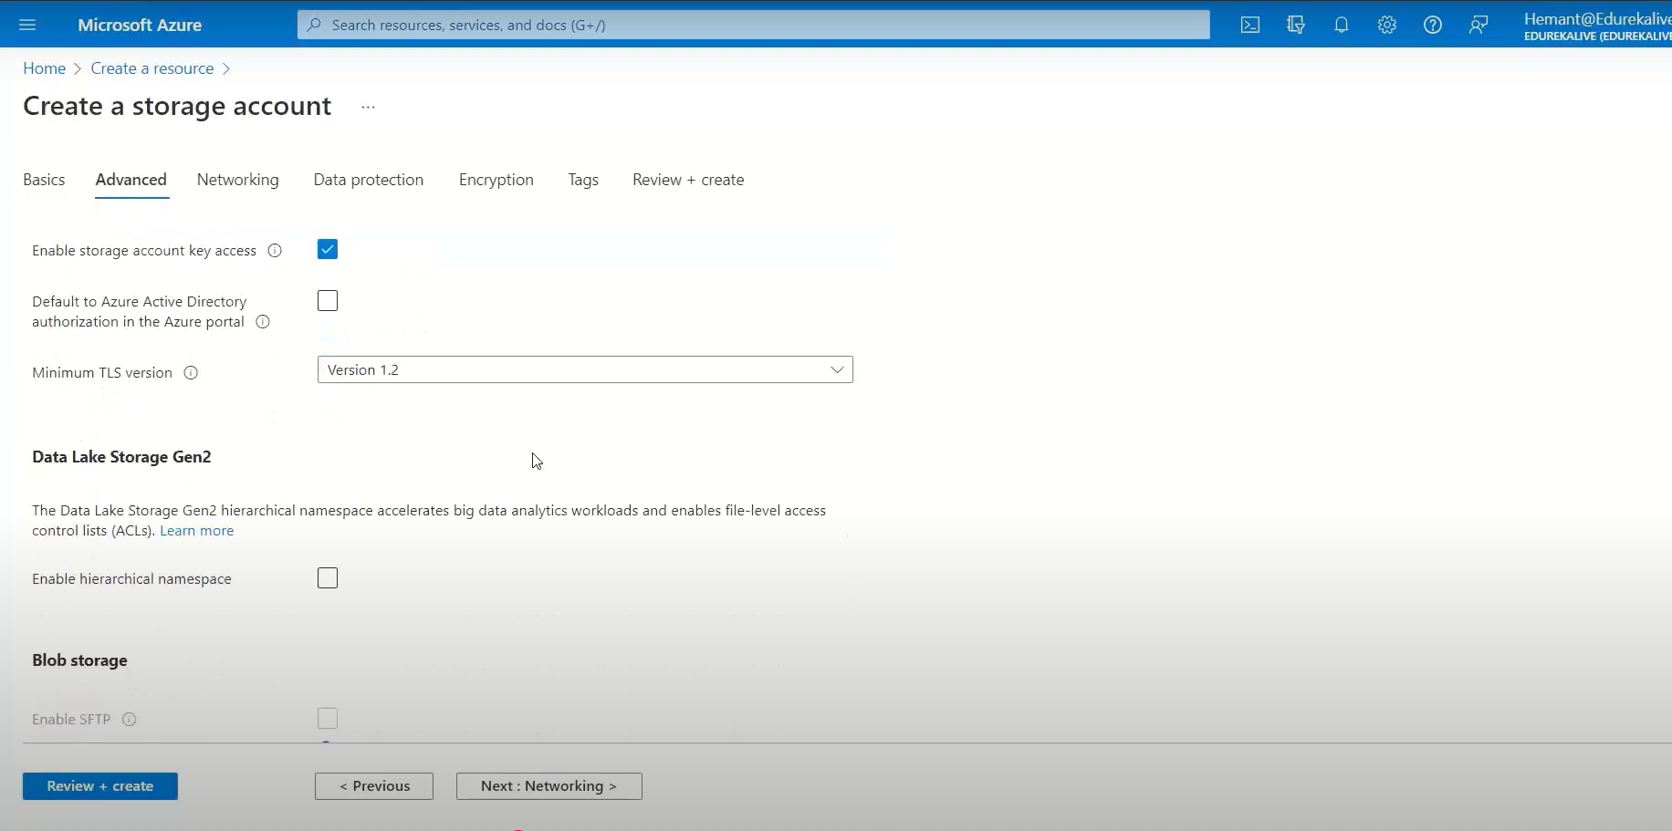

Slide 14
